Slide 1


Living the vision

Slide 2

BROAD VISION
Hope Encourage Listen Pray
India Nagaland - Network Support Children & Youth Building
A safe net
International Missions & Leadership Assignment Team
India : Ps L.Kikon (Pastor of Vision & Direction)
Myanmar : Ps Grace (Children/Youth Lead Pastor) -
Singapore : Ps Lee Keow (Lead Pastor - Counseling & Social Ministry)
Singapore : Jenny Kwek (Leader – Eng Digital Discipleship & Ministry Support)
Date of Presentation : 19 September 2025

Slide 3

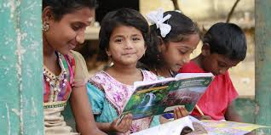
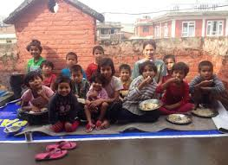
Echo from heaven
7 Share your food with the hungry and open your homes to the homeless poor. Give clothes to those who have nothing to wear, and do not refuse to help your own relatives.
Isaiah 58:7

Slide 4

Where HE Begin
Vision Statement
To see children and youth transformed by Christ, growing spiritually, emotionally, intellectually, socially, and physically, and becoming leaders who bring hope and change to their communities
The Beginning of His Calling
Matthew 11:28-30 "Come to me, all you who are weary and burdened, and I will give you rest. Take my yoke upon you and learn from me, for I am gentle and humble in heart, and you will find rest for your souls. For my yoke is easy and my burden is light."
Calling – A specific mission or role God wants you to fulfill

Slide 5

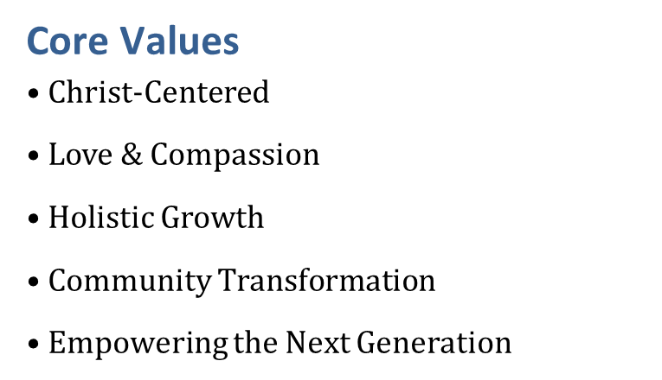
Living the vision
.To disciple, equip, and empower children and youth through biblical teaching, mentoring, education, life skills, and community engagement, nurturing them to live out their faith in practical ways.
Holy command

Slide 6

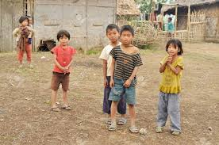
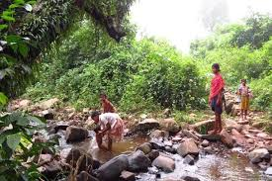
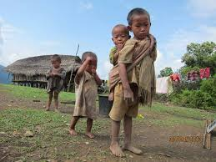
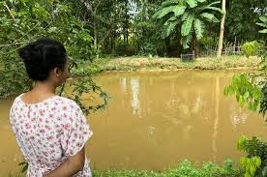
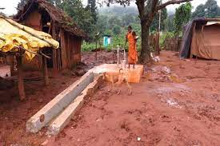
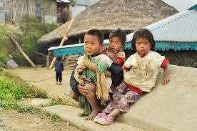
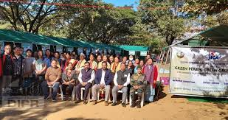
Bloom of Hope

Slide 7
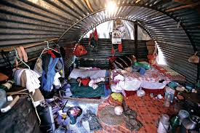
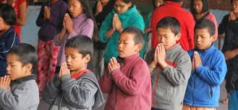
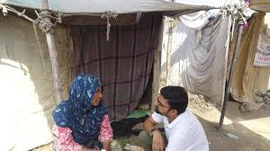
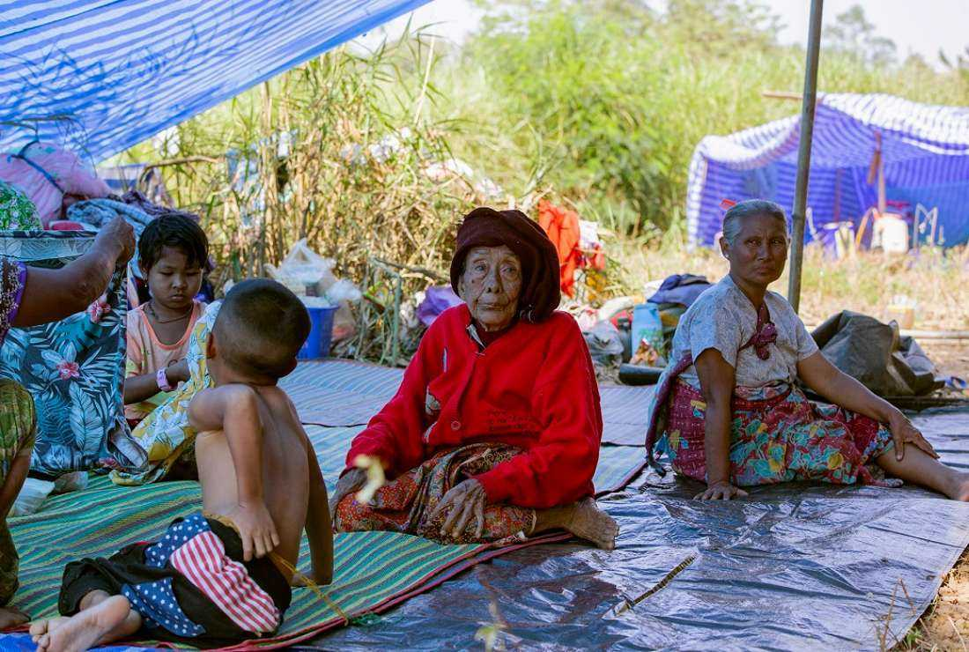
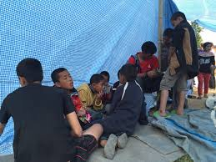
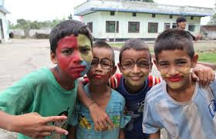
Bloom of hope

Slide 8
Inspirational Motivational
Turning dreams into reality
Living the vision
Broad Vision SMART GOAL
Specific: Support children and youth by providing programs that improve their lifestyle, values, work skills, and character development IN CHRIST LIKE
Measurable: Engage at least 50 children and youth each year through weekly workshops and mentorship programs WITH GOOD CHARACTER INSTRUCTOR ENGAGE.
Achievable: Partner with local schools, churches, and community centers to deliver these programs. (Local school, vocational center)
Relevant: Equip Focus on building a better community and fostering spiritual growth by INTRODUCING JESUS in all activities.
Time-bound: Achieve these targets within the next 36 MONTHs.

Slide 9
INTRODUCE
Physical Health & Wellness
Living the vision
Objective: Improve health and healthy lifestyles among children youth.
Strategies:
• Hygiene and nutrition education.
• Sports and outdoor activities.
• Partner with clinics for annual health check-ups.
Indicators of Success (Aim):
• Ensure 90% of children adopt healthy hygiene practices.
• Ensure to Reduce in preventable illnesses
Launch

Slide 10
SEEDING
Education & Intellectual Development
Living the vision
Objective:
Support children youth to succeed academically and develop problem-solving skills. In children youth
Strategies:
• Academic / Digital literacy Programs and literacy support
• Vocational/life skills workshops (Computer, Tailoring, Service Sector)
• Program in Intellectual Curiosity - Critical thinking, Exploration
Indicators of Success (AIM):
• Ensure 80% of students show improvement in school performance.
• Ensure 100 youth equipped with at least 1 vocational skill by Year 3.
Strategic Goals

Slide 11
TRANSFORMED
Leadership & Community Impact
Living the vision
Objective:
Develop young leaders who serve in church and transform society.
Strategies:
• Leadership training workshops.
• Involvement in outreach and service projects.
• Encourage peer-to-peer mentoring.
Indicators of Success (Aim):
• Projection 15 trained youth leaders by Year 3.
• Youth-led community initiatives active in at least 3 areas
(Bible Education, Promoting Counselling & Wellness, Gospel outreach).
Equip

Slide 12
From bold ideas to real impact, our vision timeline walks you through every step of the transformation
Living the vision
SMART Goal - Projection Outline
Year 1 – Measurable
Program Goals and Roles
Launch Bible clubs, tutoring, and mentoring programs.
Trainee Leader OJT (On Job Training)
Pilot 1–2 community service projects with measurable outcomes
Year 2 - Achievable
Add vocational skills training. (Computer, Tailoring, Service Sector)
Strengthen parental involvement.
Organize youth children camp and annual health day.
Year 3 Relevant (Project Goal)
Empower trained youth to lead programs.
Develop partnerships with local schools, clinics, NGOs.(Non-Governmental Organizations)
Evaluate impact and refine ministry strategy.

Slide 13
Vision Drive
Living the vision
Our vision drive fuels every step we take toward transforming lives
Target Soul-saving goal: 150

Slide 14
Our vision-driven goal
LIVING THE VISION
Living the vision
We aim to secure USD 50,000 to launch the foundational phase
of our mission-driven initiatives.
Program Support Requirements
Training and Capacity Budget
Equip spiritual trainers and mentors with essential skills to effectively guide new leads
Curriculum Development
Provide comprehensive curriculum materials, including Bible lessons, life skills, and health education.
Safe and Accessible Meeting Spaces
Secure safe and accessible venues such as church halls, school classrooms, and community centers.
Partial Budget Allocation
Allocate a modest budget to cover Bible , books, sports equipment, nutritious meals, and workshop facilitation.

Slide 15
Stewardship
Quarterly reports from ministry leaders.
Living the vision
• Annual review with church leaders, and youth representatives. • Track participation, school results, health improvements, and testimonies. • Adjust strategies each year based on feedback and statistics
OVERSIGHT
We ensure transparent and efficient audit management, providing our partners with clear reporting, accountability, and confidence in every financial process.

Slide 16

Leadership Support Structure
Living the vision
Primary Focus Areas:
Provides spiritual covering and intercession for the Lead Pastor and the church.
Acts as a key spiritual advisor to the Lead Pastor.
Participates in board meetings to give insight from a spiritual and pastoral perspective.
Helps discern God’s direction in key decisions.
Supports the pastoral care of staff and leaders.
Acts as a bridge between spiritual vision and organizational decision-making.
Strategy Primary Focus Areas:
Assists in board meeting preparation,
Presenting reports or ministry updates.Supports administrative and policy decisions under the direction of the Lead Pastor.
Helps ensure that decisions made in the board align with ministry needs and capabilities. Works closely with ministry heads to implement board-approved plans.
Acts as a liaison between leadership and board, helping manage communication.

Slide 17
REGULAR ASSESSMENT FOR Trained Youth Leader
Living the vision
1. Spiritual Growth
Do they pray and read the Bible regularly?
Are they showing kindness, patience, and love?
2. Good Character
Are they honest and responsible?
Do they accept feedback and try to improve?
3. Leadership Action
Are they taking the lead in helping others?
Do they mentor or guide people?
4. Positive Relationships
Do others respect and trust them?
Are they helping to bring people together?
5. Living Their Faith
Do they show Christ’s love in everyday life?
Are they involved in serving or helping their community?

Slide 18
🌱 Creative Fundraising & Sustainability Plan
Living the vision
🔑 Goal:To build a monthly donor membership base and create self-sustaining revenue streams using the youth’s talents (art, music, sewing, cooking) while deepening community engagement.
🎶 Café Busking & Storytelling Nights
🎤 What:Host weekly or biweekly café nights where youth perform live music, poetry, or drama (busking style).Feature testimonies or personal stories of how the café and worship space has impacted them
.🎯 Purpose:Draw new visitors and local supporters.Capture emotional moments for video content.Offer a donation box + sign-up table for monthly supporters.
✅ Action Steps:
🎥 Media Creation for Donor Campaign
📹 What:Produce short, high-impact videos and social media posts to launch a “Become a Monthly Member” campaign.Feature:Youth sharing their storiesBehind-the-scenes café and worship momentsShowcasing gifts they create for donors

Slide 19


Closing Message
Living the vision
Your generous support, guided by the love of Jesus, can transform the lives of children and youth by giving them the education and skills they need to succeed
Means not just talking about mission or goals, but actively walking it out in daily life. It’s when leaders, teams, and communities embody the values and purpose we've committed to in every action, every relationship, and every decision
Living the Vision
Thank you Your kindness means so much to us

Slide 20


Living the vision

